Slide 1
Gifting as an Opportunity for Export to Asia
Focus on SME’s

Slide 2
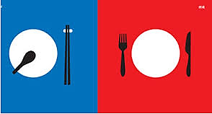
West is Not East!
Society tends towards Individualist
Tending towards promotion focused, independence, self interest, positive distinction of self from others, self actualization is valued, private opinions expressed
Society tends towards Collectivist
Tending towards relationship based, interdependence, harmony, adherence to groups norms, prevention focused, avoidance of negative social outcomes, importance of maintaining “face”
Source: ITRB Report 1

Slide 3
The need for Insights
Over 2600 unique cultural consumer segments across Asia*
China is more culturally/linguistically, religiously and genetically diverse than the EU*
Culture Really Matters!!!
Source: Euromonitor 2011 Asian Century

Slide 4
Most Asian Cultures are Gifting Oriented
Chinese cultures for example is a gift culture. Every important meetings is made more successful by the exchange of gifts.
To be empty handed when receiving a gift from your Chinese host is not only somewhat rude, but will put you into a position of future debt in the minds of the Chinese.

Slide 5
Size of Gifting Industry: China
The gifting industry was valued at RMB 800 billion (169.9 billion A$) ¹ in 2013.
Imported food and beverage are frequent gifts during Chinese holidays and other occasions and demand has stayed strong.
However due to government anticorruption campaigns, the value of gifted products is lower than pre 2013 levels. The marketing of high end products has shifted away from themes of luxury and moved towards indicators of success.
Sources: 1 http://www.bbc.com/news/world-asia-china-24148146

Slide 6
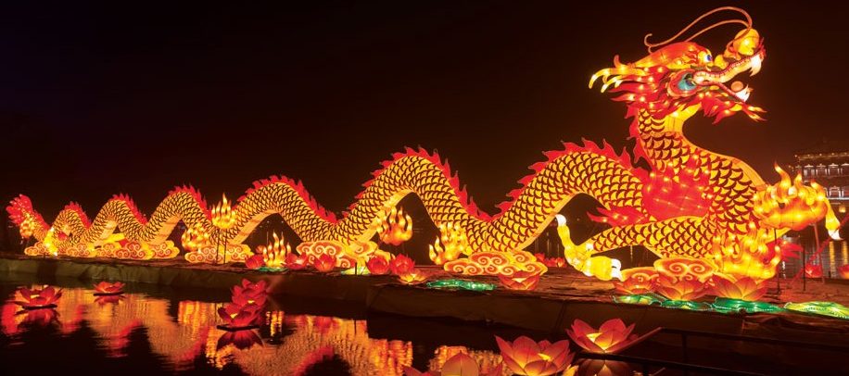
Chinese New Year and Food Gifts: China
Consumers are spending ever increasing amounts on nianhuo 年货 (New Year products) with imported food taking up an increasing share.
Online retailer YHD (Walmart), reported that imported food and drink accounted for 37% of nianhuo purchases in 2013 and 47% in 2014. Total sales in 2014 increased 100% from their 2013 levels and the range of products available grew from 14,000 to 70,000 ²
Womai, the e-commerce platform, predicted that its sales of imported products in 2015 would triple the level reached in 2014 with demand driven by families in tier 1 cities. ²
The purchases made for Chinese New Year differ from gifting in that they can be done for family consumption and cooking rather than for business purposes and whilst concerns of “face” are still applicable products are more likely to have mid-price points.
Sources: 2 Spring in the air for food imports http://www.chinadaily.com.cn/business/2015-01/10/content_19287687.htm

Slide 7
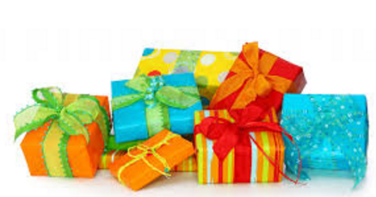
Gifting in Asia… Different than the West
There are a strict set of etiquette based on traditions, superstition, and even numerology.
The rules of saving face also apply, particularly when giving and receiving gifts.
When to Gift in Asia
Generally, gifts are given for:
Everyday sharing with friends, Trinkets for co-workers
Treat or Reward
Gratitude, Thank you
A Business Gift
A Visiting Gift
Celebration of an Occasion such as a festival gift, birthday, etc
Showing Respect/ Hierarchy
More Everyday
More Premium
In Asia, gift exchanges are often separate, one-way giving events. Avoid gifting a single person when in a group setting (e.g., at a business meeting). Instead, gift the entire group or wait until you are in private to gift an individual.

Slide 8
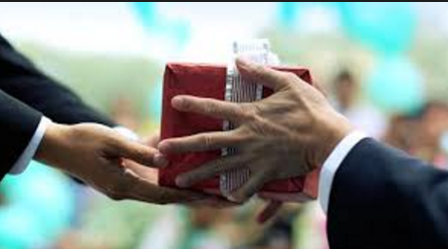
There are lots of cultural differences in Giving Gifts
General Etiquette for Giving Gifts in Asia
No matter how much time or effort were put into selecting and wrapping something, you should downplay your gift as insignificant.
Expect that your host may politely decline your gift several times before finally relenting. This is simply custom and does not mean that they aren’t happy about your gesture. Express gratitude that your gift was accepted.
Don’t be surprised if your gift is simply put aside to be opened later. Gifts are often opened in private to avoid any potential embarrassment and loss of face for either party.

Slide 9
Culturally Acceptable Gifts: China
Wine: Seen as a toast to good health of the receiver.
Cigarettes: Good Quality are expensive. Will boost face and prospects of the receiver.
Health Supplements: Good gift for older receivers to boost their health.
Peaches: Good gift for longevity.
Red Envelops with Money Inside: Generally for kids at Festival times
Australian/ Regional products: Considered very proper and impressive.
Special Teas: Good Quality, good for everyone.
Books

Slide 10
Culturally Unacceptable Gifts: China
Clocks: The sound of the word is close to death or funeral. You are suggesting the person should die. A Big No No.
Pears: The sound of the word is close to separation. You are suggesting the family should dissolve.
Umbrella: The sound of the word is close to fall apart. You are suggesting the relationship should end.
Handkerchiefs: Given at the end of a funeral to say goodbye.
Knives/ Scissors/ Sharps: You are suggesting the relationship should end.
Green Hat: You are suggesting the receivers partner is cheating.
Shoes: You are suggesting the relationship is ending.

Slide 11
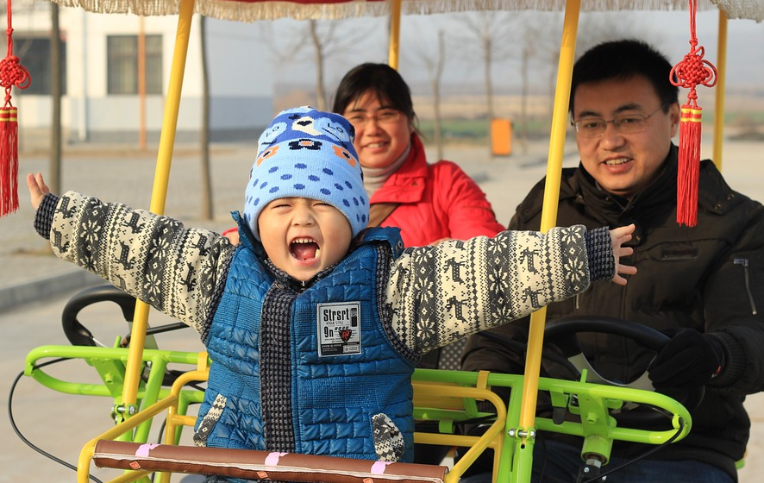
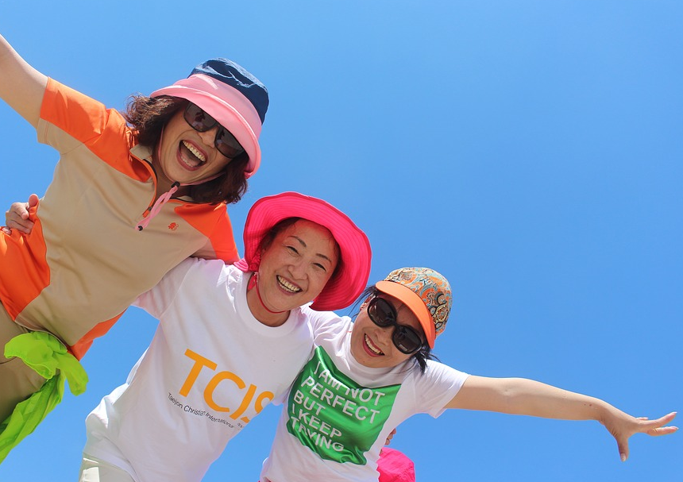
Closeness of the Relationship
Very Close
Distant
Family/ Share with all
Candy and fruit are acceptable, but preferably not for dinner occasions
The Gift should be a larger size with familiar flavours to share with all
Toys for kids
Useful kitchen items (avoid sharp objects)
For closer relationships
An item that indicates you know the recipient’s hobbies/interests
For more distant relationships
More culturally acceptable good gifts.

Slide 12
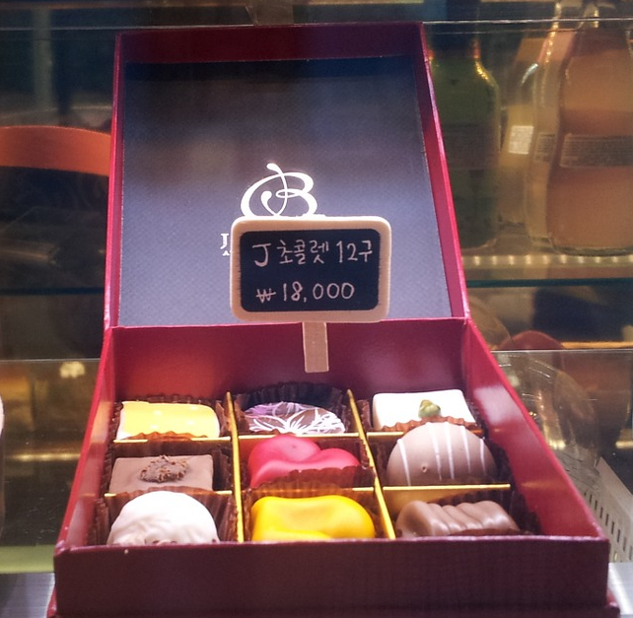
Food and Gifting
Key elements are expected by consumers before even considering food as a gift.
Food Safety: is more important as incomes increase and if the receiver has children in the home. This is also important when considering giving gifts to others, as these food gifts would be interpreted as representing what the gifter thought of the receiver.
Origin: Australia, New Zealand, USA and Europe are considered to be clean and green with a good food safety record. Imagery of pastoral, natural scenes reflect the level of cleanliness of the foods.
Australia vs New Zealand: Consumers related Australia with modern, sophisticated, multi cultural, diverse, and international. They related New Zealand with a stronger national culture that is more pure, family oriented, old fashioned, and Caucasian
Fit to Cultural Norms of Gifting: The Cultural norms are more complex in Asia than in Australia, and this drives the type of gift expected. Giving a culturally acceptable gift, ensures the gifter is well considered.

Slide 13
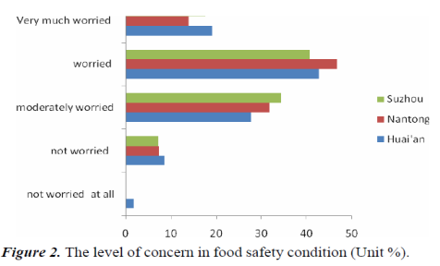
When Giving Food, Trust Matters
Food Safety is a concern for consumers especially when the food is manufactured in China. With the number of incidents of food safety concerns (Melamine in milk, poisoned bean sprouts, dyed steamed breads, mishandled or modified meats, etc) have caused not only Chinese consumers to be concerned about the food supply, but also consumers who might have foods of Chinese supply available to them in their markets.
The CONTRAST EFFECT of this supply vs. the clean, green and food safety managed supply of foods from Australia and New Zealand drives consumers to question the origin of their foods and perceive an enhanced value to food from Australia and New Zealand that they are willing to pay more for.
Source: An empirical study on consumer perception of food safety risk - An example of food additives Journal of Food, Agriculture & Environment 2012
Food from a known supply (ie Australia, New Zealand) was perceived as more safe than other locations like the US, Europe, local markets and China. This concern over food safety and origin caused many consumers to read labels in depth to check the origin of supply, and to research food manufacturing sites.

Slide 14
When Giving Food, Origin Ensures Trust
While Australia and New Zealand are considered very similar in many aspects there are some strong perceived differences. Both countries are perceived as natural, lush, relaxed, and friendly. Australia is perceived to be more sophisticated, multi cultural, diverse, modern, and international. While New Zealand has a stronger national culture and is more pure, family oriented, old fashioned, and Caucasian. Imagery of pastoral, natural scenes reflected the level of cleanliness of the foods.
 | Australia – Naturally Diverse | New Zealand – 100% Pure
Culture | More sophisticated (Opera house) Multi Cultural (always a picture of their race in the imagery), More diversified, Modern | Maori People, National Culture.
Precious Things | Kangaroos, Koala, Crocodiles, Freedom, Blue Sky, Cows | Sheep, Unpolluted, Spring water, Volcanos
Food | Shrimp, Lobster, Seafood, Meat, Cheese, Wine, BBQ, Clean, Green, Natural | Milk, Mutton, Delicious, Natural, Pure
People | Passionate, Active, Outgoing, Curious, Easy to Get along with, Live a long life, Self Confident, All Races | Friendly, Slow pace of life, Very Caucasian, Family oriented
Lifestyle | Peaceful, Laid Back, Relaxed, Natural, Comfortable, International, Fashionable, Open to new ideas, Active in Nature, Surfing. | Natural/ Garden like, Active in Nature, Surfing, Fishing, More old fashioned, Open to new things/ ideas

Slide 15
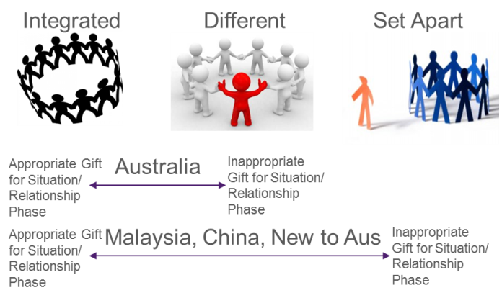
When Gifting - Getting it Right Matters
Gifting is about connecting to others and building relationships. It is a fundamental behaviour across all societies. Within each society there are cultural norms that when intentionally or unintentionally are not observed, the consequences have impact. For Asian cultures getting it wrong has a higher impact than in Australia. As the overall cultural norms become more traditional, the impact is greater. This drives an enhanced need for more “Socially Safe” gifts that fit cultural norms.

Slide 16
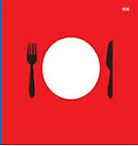
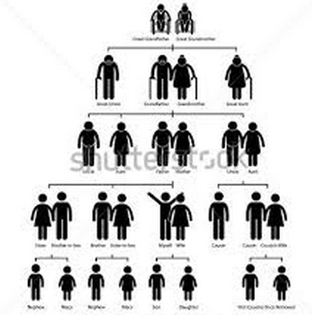
Differences between West and East
Features of Gift Giving | West | East
Obligation to Reciprocate | Reciprocity not necessarily expected but likely to happen in the near future An emphasis on equal value in the reciprocated gift | Strong feelings of indebtedness and obligation to reciprocate Reciprocation not immediate (wait for suitable opportunity) Reciprocated gift usually equal or greater value to that received
Role of relationship with recipient | Reciprocity encouraged in families More willing to accept small gifts from acquaintances Perceive giver as recipient oriented and don’t experience feelings of indebtedness | Different gifting patterns for different relationships Reciprocity discouraged in families Less willing to accept small gifts from acquaintances Perceive giver as personally motived and experience strong feelings of indebtedness

Slide 17
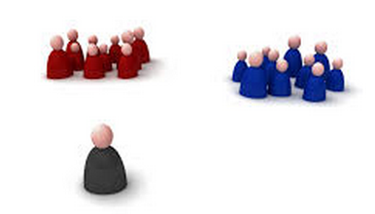
Differences between West and East
Features of Gift Giving | West | East
Importance of maintain “face” | Face interpreted differently in western settings Luxury consumption generally motivated by personal preferences or materialism | Maintaining the face of the giver and recipient is highly important Due to cultural emphasis on mianzi/ and social conformity, will often purchase luxury products as gifts- these symbolize respect for and esteem of the recipient and maintain the face of the giver
Escaping the Gift Economy | The gift economy can evoke strong feeling of obligation and pressure to reciprocate Individuals can escape the gift economy by resorting to a market economy approach | Strong obligations to reciprocate cause anxiety, especially give the emphasis on guanxi as a social institution

Slide 18
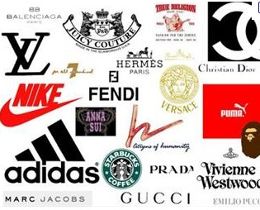
Gift Elements
Brand
Most Important
Package
Product

Slide 19
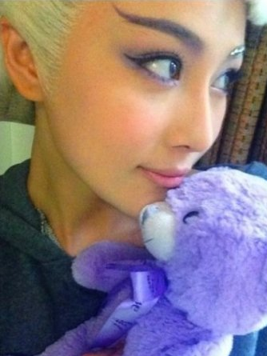
Premium Brands are Emotionally Engaging with a compelling story
The brand should be known in Australia, before exporting
Heritage and age matter. Older brands means that issues of food safety have been dealt with.
A brand story of uniqueness and providence is very compelling. As is having a famous Chinese celebratory shown with your product on social media.
The furry bear appeared with glowing endorsement on social media accounts of model Zhang Xinyu and other Chinese celebrities.

Slide 20
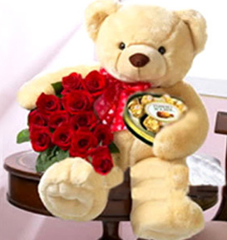
Occasion and Bundling Matters
Most gifts are generally considered and purchased with another category
Shifting a gift from consideration to purchase is more effective when it is paired with another category. The effectiveness of the pairing is impacted by the occasion.
Sales can soar when companies bundle products together into one cheaper package. However, the bundle is more likely to be successful if the consumers is given the option of buying the same products separately.
Vineet Kumar, an assistant professor in the Marketing Unit at Harvard Business School. HBS Working Knoweldge: 01 OCT 2012 RESEARCH & IDEAS Better by the Bundle? Dina Gerdeman

Slide 21
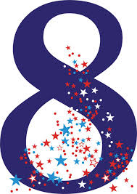
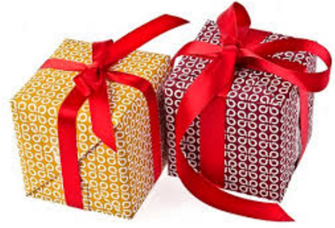
Numbers matter
The number 8 is considered very auspicious in Chinese culture because it sounds similar to ‘prosperity’ and ‘fortune.’ In general, giving an even number of items is more favorable than an odd number, however, the number 9 is an exception, as it sounds close to the word for ‘long-lasting.’ Other lucky numbers include 2, 6, and 8.
In the Western world, 13 is generally considered an unlucky number. The equivalent in Asia would be the number 4. In China, Korea, Japan, and even Vietnam, the number 4 is considered extremely unlucky because it sounds close to the word for ‘death.

Slide 22
Key Elements for an Asian Gift
Surprise and Mystery
How the gift is packaged is a key component as this is used to judge the importance of the gift and the relationship.
This can mean no windows, as this takes mystery away from the gift.
When gifting the package may not be opened in front of you, but instead opened later.
The number of layers before getting to the final product drives the level of premiumness. 3-5 or more layers is premium.
Gift in Pairs
Pairs suggest the harmony of yin and yang.

Slide 23
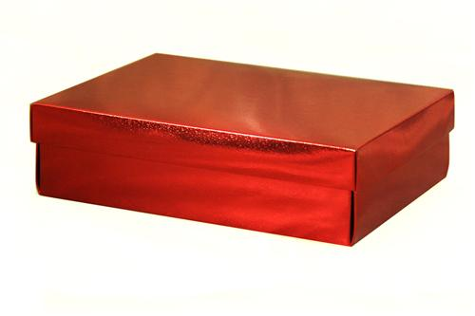
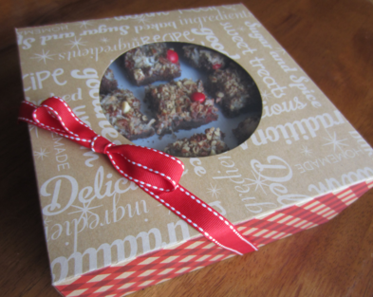
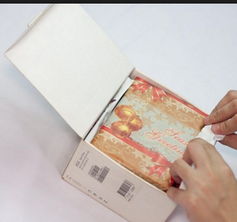
Premium Packaging reinforces Emotionally Engagement
Surface Texture
Most Important
The more tangible, authentic and familiar associations a surface cues on a gift box, the more premium it is perceived to be. If slippery to touch, considered cheap.
Shape
More traditional shapes reflect safer choices. Square = Safe, Round = Harmony and Happy endings. Off centre shapes are not harmonious. Shape is more important than size.
Unveiling
The more premium the gift, the more layers to build anticipation while opening.
Aus
China

Slide 24
Packaging: Colour and Embellishments
Presentation is Important, as the gift may not be opened immediately. The presentation is just as important for the occasion as the gift inside
Colour
Red packaging is the best outer colour for most occasions.
Pink is an acceptable colour for a girl.
Gold and silver work well for weddings.
Blue, white, and black packaging should be avoided because they remind people of funerals.
Embellishments
Gold, silk ribbons indicate fortune and wealth.
While red is the most auspicious colour for packaging, avoid writing cards in red ink, as this suggest the end of the relationship.

Slide 25
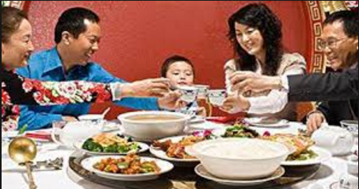
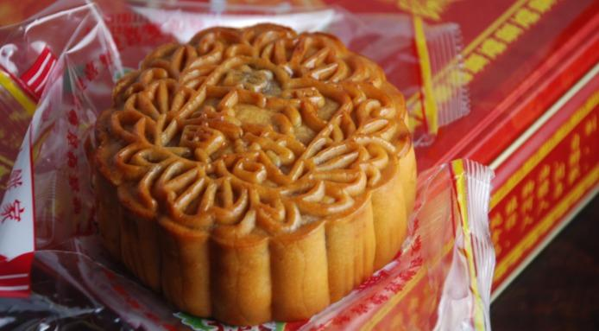
Premium Products
Fit to Familiar tastes, Fit to familiar culture and behaviours
Most Important
Appearance: “Eat with your eyes”
Safe and Unique Ingredient(s) from Australia

Slide 26
Food Harmony: Familiar taste and culture
Pairings:
Food and beverages are often paired to complement flavours and to maximise perceived health benefits using the heating/ cooling classification system.
Heating
Ingredients will be classified according to their mode of preparation and properties with oily food, meat, spicy food, or sweet food.
Cooling
Foods such as vegetables, sour flavours, and low calorie value foods.
Dishes or combinations of dishes that are not balanced according to this system are seen as unhealthy and where consumers do not know how best to complement a European ingredients or products they may be hesitant to purchase them.
Source: Anderson, Eugene N. (2013), "Folk Nutritional Therapy in Modern China", in TJ Hinrichs and Linda L. Barnes (eds.), Chinese Medicine and Healing: An Illustrated History, Cambridge, Mass.: The Belknap Press of Harvard University Press, pp. 259–260

Slide 27
Key Take Aways
Gifting is a common behaviour in Asia. Imported foods and beverages are most often given during festival and special occasions and the market is growing.
There are expected norms and behaviours to gifting.
Food Safety, Indicators of success, per capita wealth, modernity are all driving the choice of imported foods and beverages as a gift.
Australia has some unique country of origin elements. More than clean and green.
There are over arching design rules to the packaging and product for a premium food and beverage gift. Understanding these allows for a greater perception of premiumness of the gift.

